Slide 1
Making
Character Inferences
I can make character inferences through analyzing the author’s use of direct and indirect characterization.

Slide 2
What is an inference?
A conclusion based on evidence and reasoning
I wouldn't eat after that two-year-old if I were you.
Inference: The two-year-old probably did something gross to the food you were about to eat or has a cold and you could catch it. Something bad will happen to you if you eat it!

Slide 3
How do I make a character inference?
Look where author uses Direct and Indirect Characterization
What does this evidence suggest about the character?
How can I express this in the form of a claim?
Use previous knowledge to reason out why you think this
What experience do I have that leads me to interpret this evidence in this way?
Could this evidence be interpreted in another way?
Verify your reasoning
Is my reasoning valid and supported by other evidence in the text?
Is there any textual evidence that contradicts my inferences?

Slide 4
Inference Formula
What’s said in text
What we already know
Educated Guess: inference
+
=

Slide 5
Make your own inference:
A man ran after a retreating bus, waving his briefcase frantically.
Inference:
What specific parts of the sentence helped you infer?
What previous knowledge did you use to make this inference?

Slide 6
Make an inference:
A woman walks into a hospital clutching her abdomen and cursing out her husband, who trails behind her carrying a large bag.
Inference:

Slide 7
Make an inference:
What does the text (image) tell you?
What previous knowledge helped you infer what happened?

Slide 8
Make an inference:

Slide 9
Common Mistakes
Letting Experience Trump Evidence
TEXT should define your inferences
Previous knowledge gives reasoning for them
Not Thinking Deeply Enough (Literal vs. Figurative)
Interpreting metaphor or other figurative language as literal
Shallow Inferences
Evidence: Character plays basketball
Inference: The character likes basketball.

Slide 10
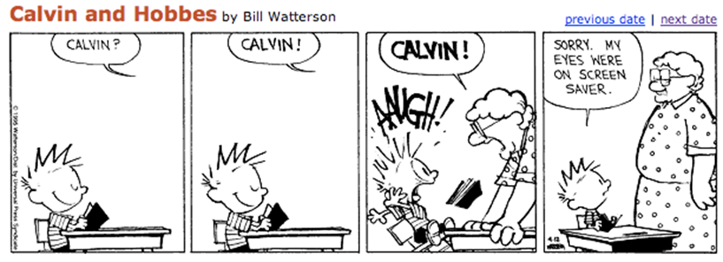
Previous Knowledge:
What previous knowledge is needed to understand this comic?

Slide 11
What do we infer about characters?
Character Traits-
Descriptive adjectives like angry or sensitive
Character Motivations-
Reasons behind character’s actions

Slide 12
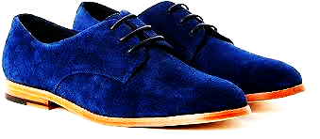
Character Inference Practice:
1st- Read “Thank You M’am” as a class (pg 108)
2nd- Individually or with ONE other partner, choose a character to analyze. What traits can you infer about the character? Make a chart in your notebook like the one below. You must make at least three inferences and use at least one direct quote from the text to support each!
Trait/Inference
Actions and/or Dialogue that lead me to this inference:
I can make character inferences through analyzing the author’s use of direct and indirect characterization.

